Slide 1

.

Slide 2
Index
Threads and processes
Cooperating / competing tasks
HTTP Protocol and Websocket
Socket / Websocket
Conclusion

Slide 3
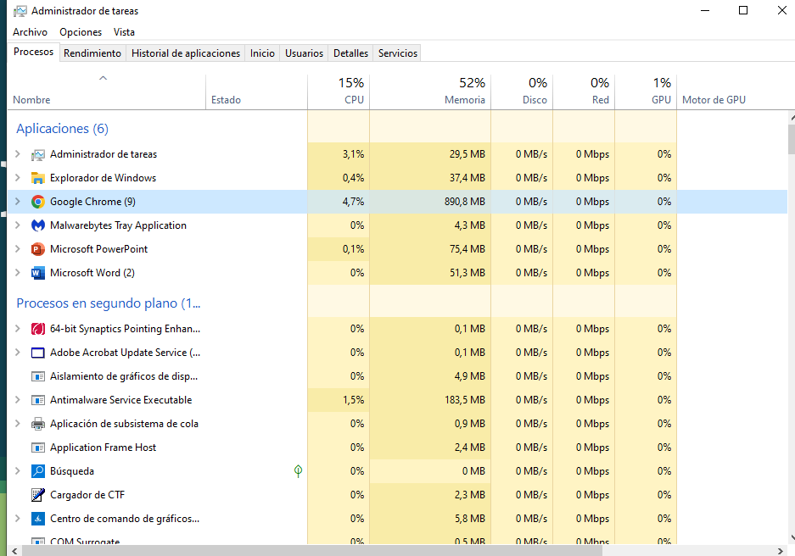
PROCESSES

Slide 4
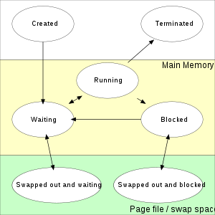
Processes and its states

Slide 5
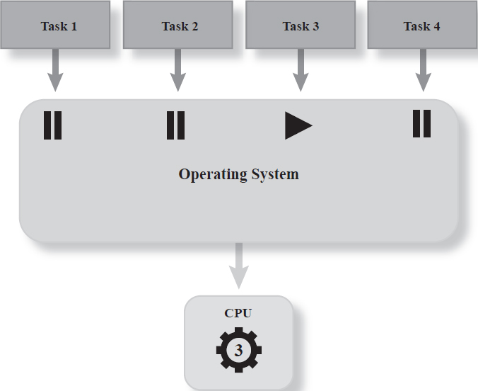
TASKS

Slide 6
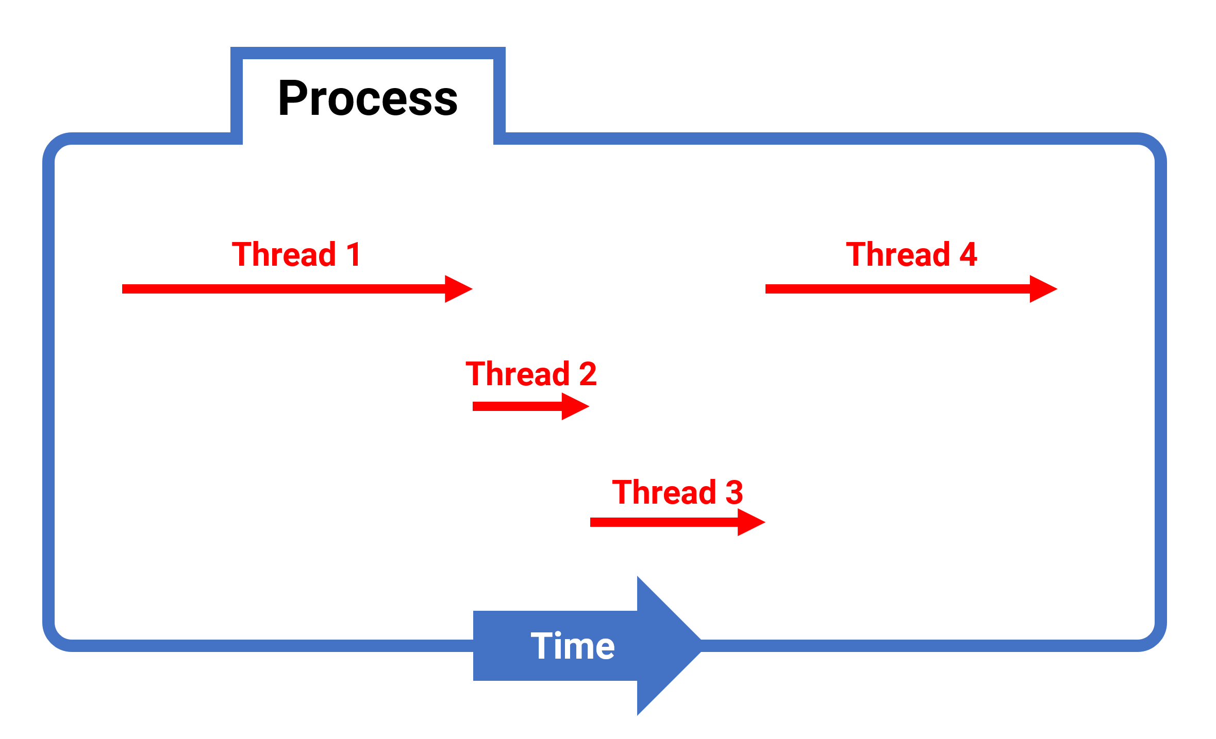
THREADS

Slide 7
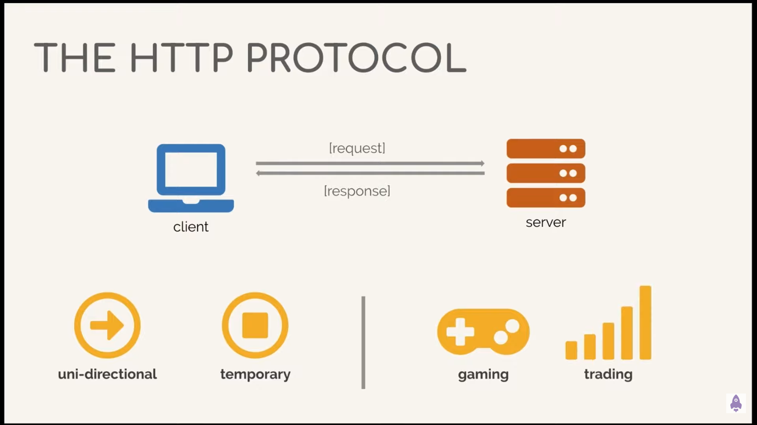
HTTP Protocol

Slide 8
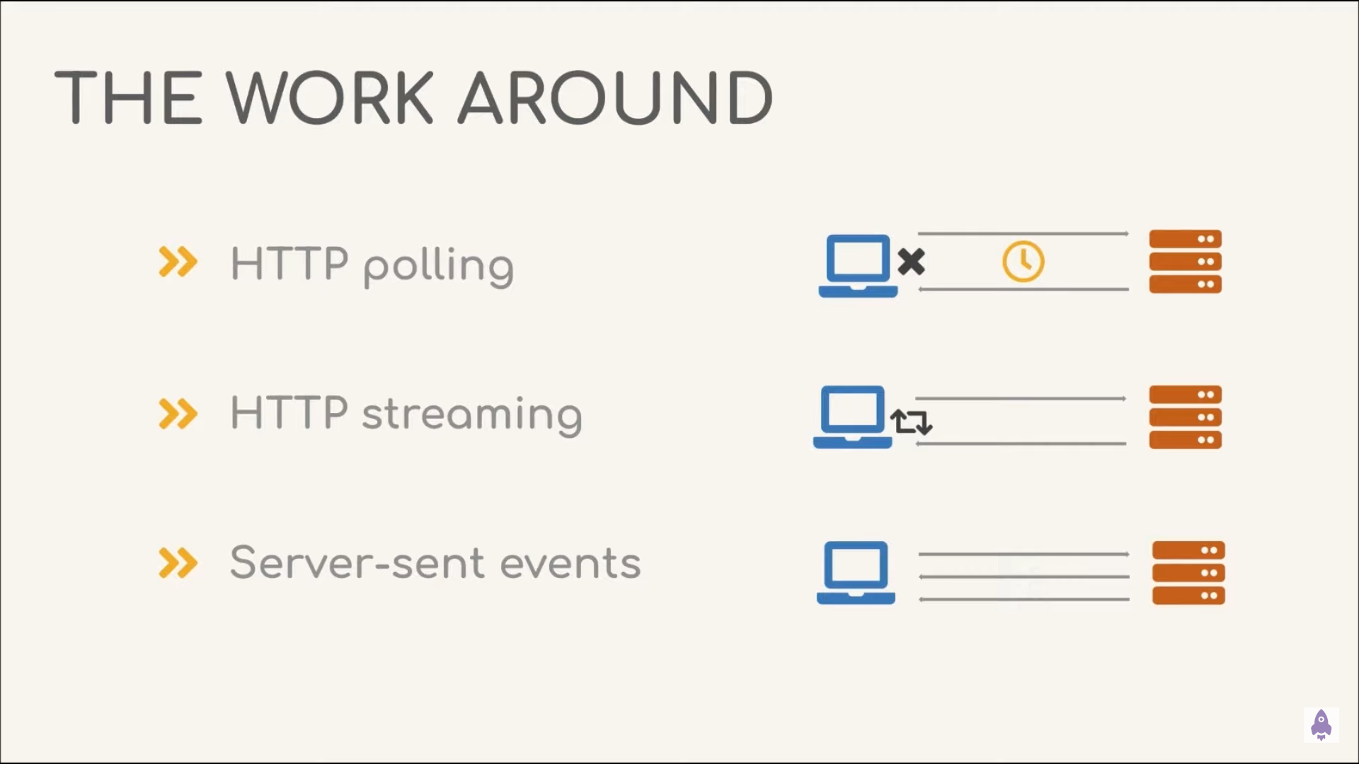
HTTP Protocol

Slide 9
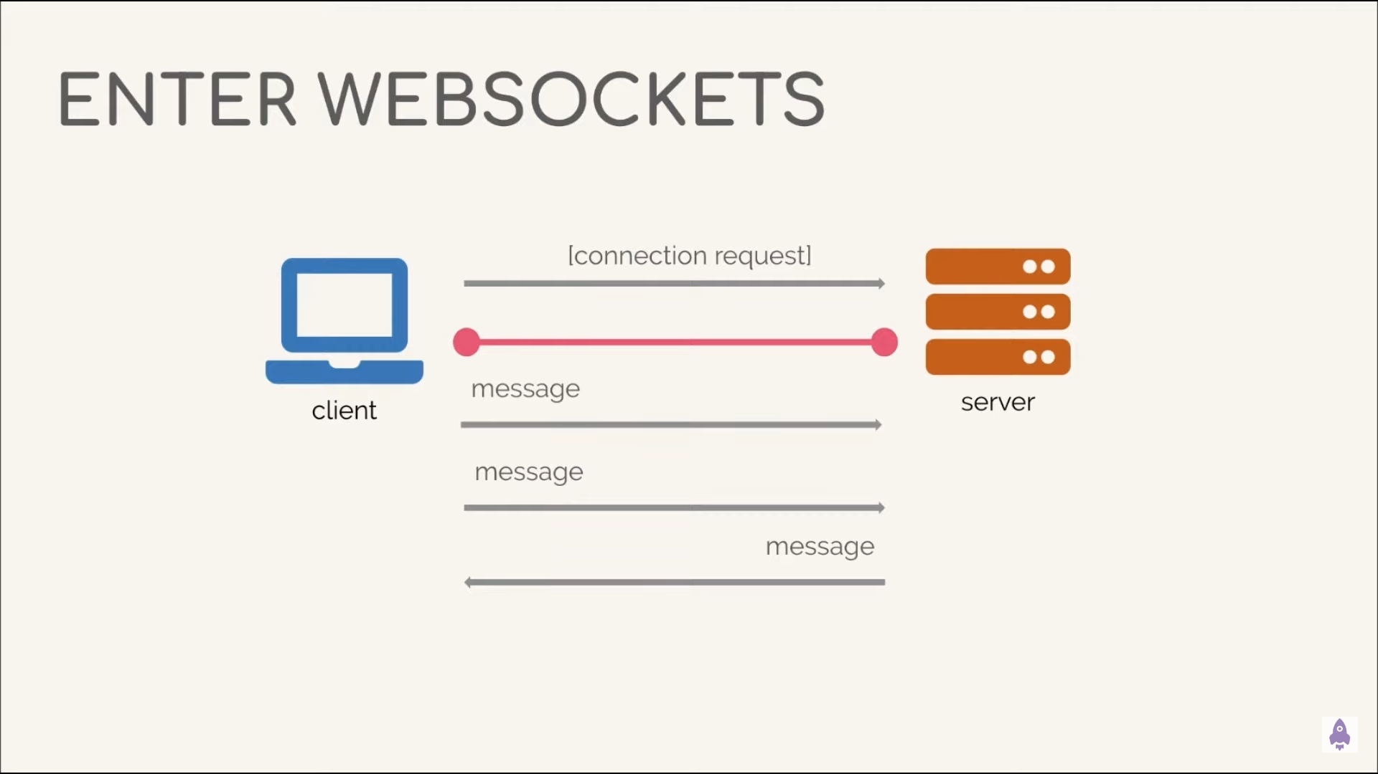
HTTP Protocol

Slide 10

Socket
WS

Slide 11
Socket and Websocket
Client
Server
Websocket
HTTP Protocol
Socket

Slide 12
THANKS!
Any questions?

